Slide 1
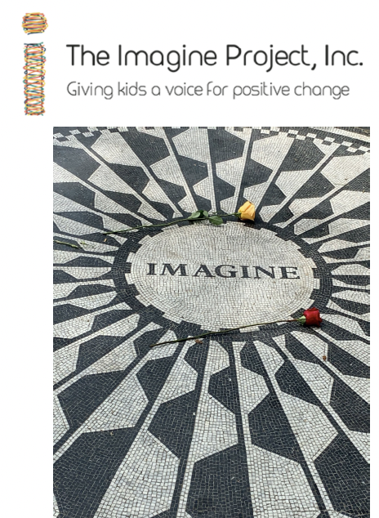
MENU
The Imagine Story
(9 slides)
Culturally Responsive Teaching (3 slides)
Social Emotional Learning
(7 slides)
Exploring Emotions
(5 slides)
The Design Cycle
(4 slides)
Text, Song, and Idea Resources
(three slides)

Slide 2

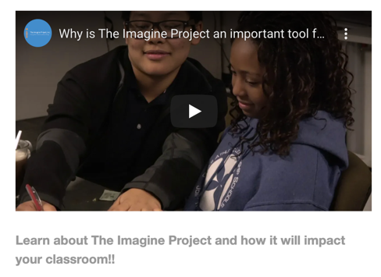
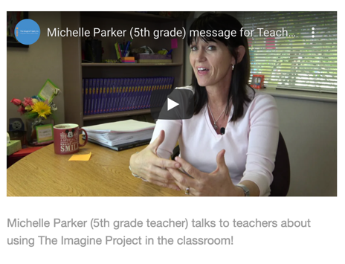

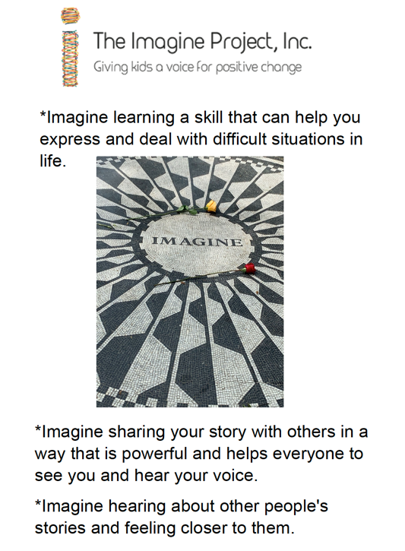
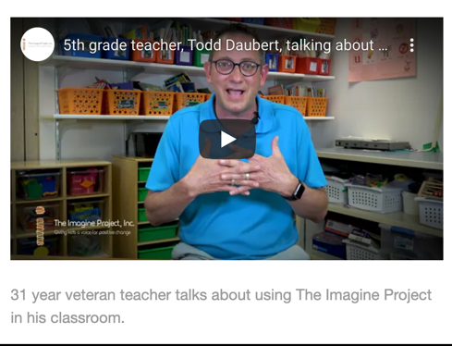
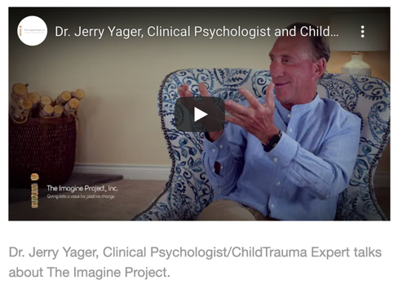
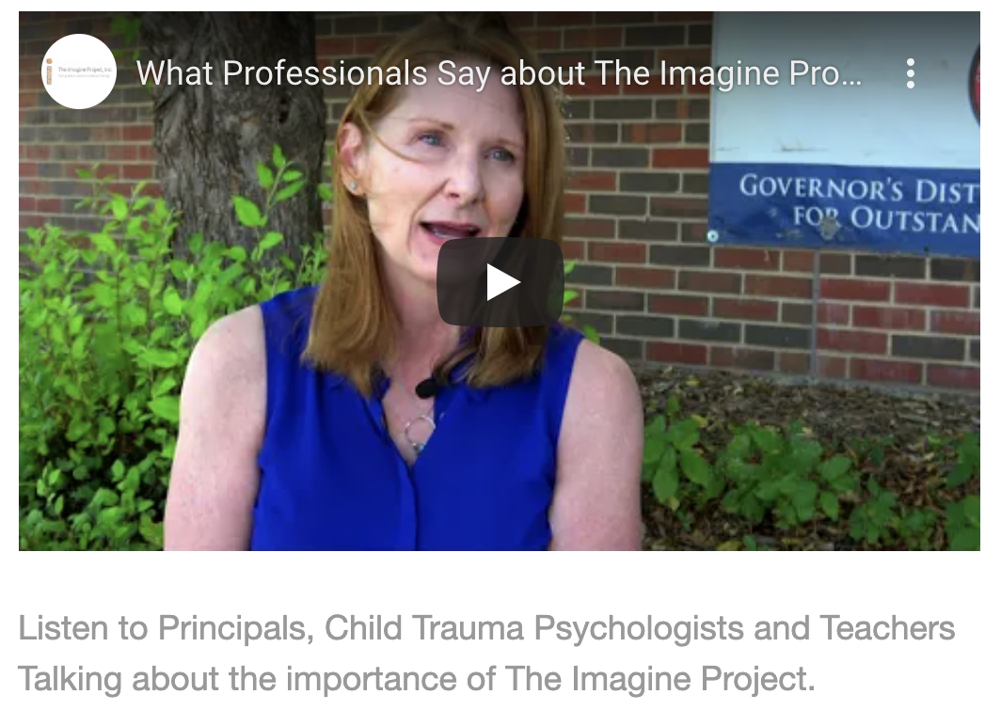

Home
for the teacher…
Professional Development Resource
The Imagine Project: Empowering Kids to Rise Above Drama, Trauma, and Stress
by Dianne Maroney
Next

Slide 3

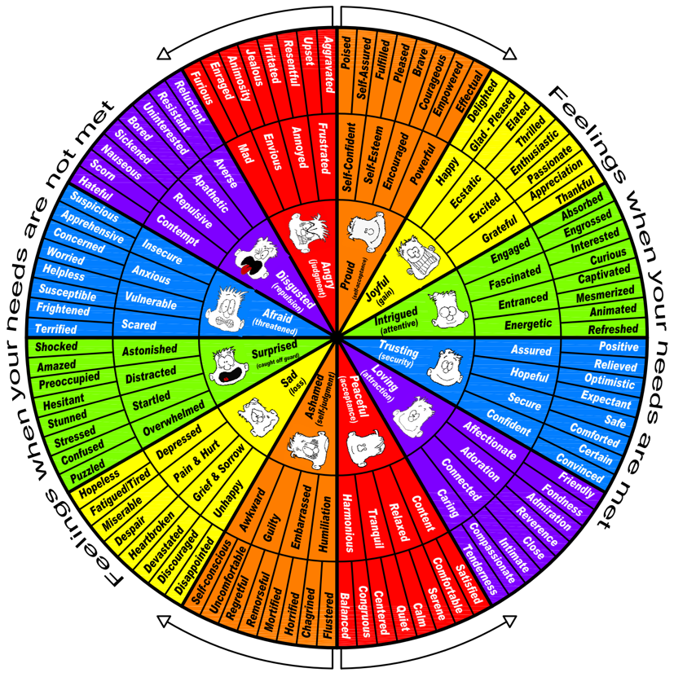
Celebrate!
*What are you proud of or what do you feel good about your life?
*Use the feeling wheel and write the emotions that match the items you listed.
Home
*Watch the story, Ruby Bridges, or another text from the resource section.
*What did Ruby have to celebrate? How did she feel?
Play “Beautiful” by Christina Aguilera or other songs from the resource section while students write what they are proud of.
Next

Slide 4

Home
Reflect
*Make a list of things that have been challenging or difficult in your life.
*Write the emotions that match the items you listed.
Play “Story of my Life” by One Direction or other songs from the resource section while students write about their challenges.
*Watch the story, Big Al or another text from the resource section.
*What challenges did Big Al face?
*How did he feel?
Next

Slide 5

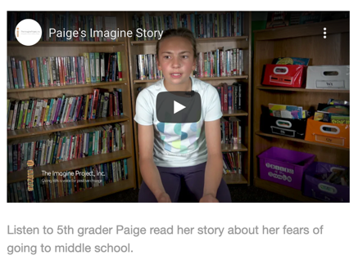
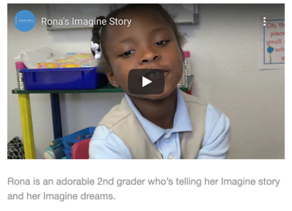
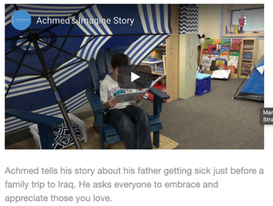
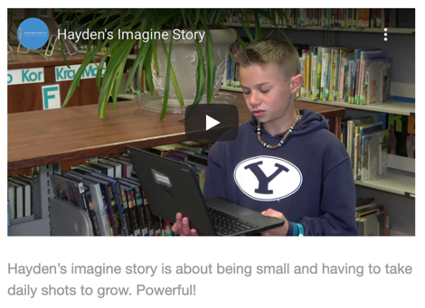
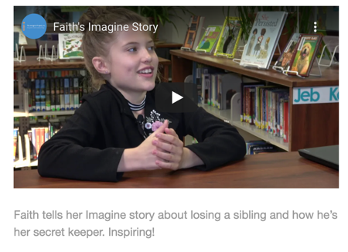
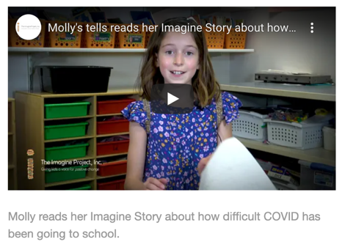
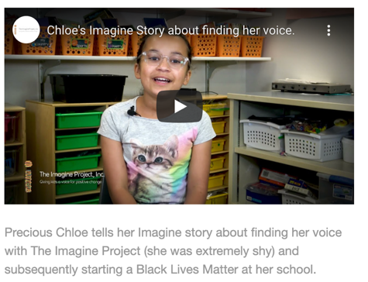
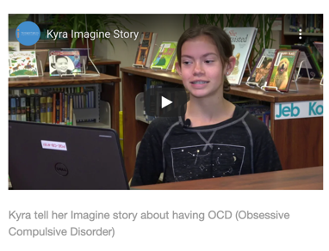
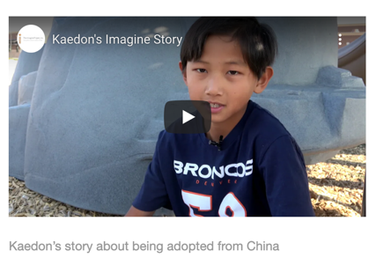
Watch some video examples to become inspired to write your story.
Home
Next

Slide 6

Write your story
Choose one challenging experience in your life.
*Start each line with the word “Imagine…”
*What does your heart and mind think of first when the incident comes to mind
*Use “you” instead of “I” to tell your story.
Home
*Show your feelings
Imagine… having dyslexia and being embarrassed that you are not a good reader.
Imagine… reading and words becoming fuzzy and the words not taking shape.
Imagine… being mad, a slow reader, and feeling very dumb.
Imagine… getting bullied for not reading well.
Imagine… hating school because people tell you you are stupid.
Imagine... not being able to think or focus on one thing or on a test.
Imagine... listening to your mind, your only friend, hurt you.
Imagine... not being able to give your mom a great big hug when you need one because you are all the way at school.
Play “Three Little Birds” by Bob Marley or other songs from the resource section while students write their stories.
Next

Slide 7

Make the Hopeful Turn
*Dream about what you want to do in your life!
*How can you write a new ending to your story?
*End with putting your hope into action.
Home
Read the book Emmanuel’s Dream. Discuss how Emmanuel rose above his challenges.
Imagine... being able to look at the world with many ideas and perspectives. You decide.
Imagine... if you could overcome ADHD and push it out of the way.
Imagine... if you could mold a world of your own with your mind!
Imagine… if you could get work done without getting distracted constantly.
Imagine…that your ADHD will be your superpower one day.
Imagine… learning to read and feeling pride.
Imagine… people helping you learn to read and persevere.
Imagine… feeling pride to overcome the obstacle of reading and starting to like school again.
Imagine… being a good student, reader, and one day, being a teacher to help others read.
Play “Rise Up” by Audra Day or other songs from the resource section while students write their hopeful turns.
Next

Slide 8


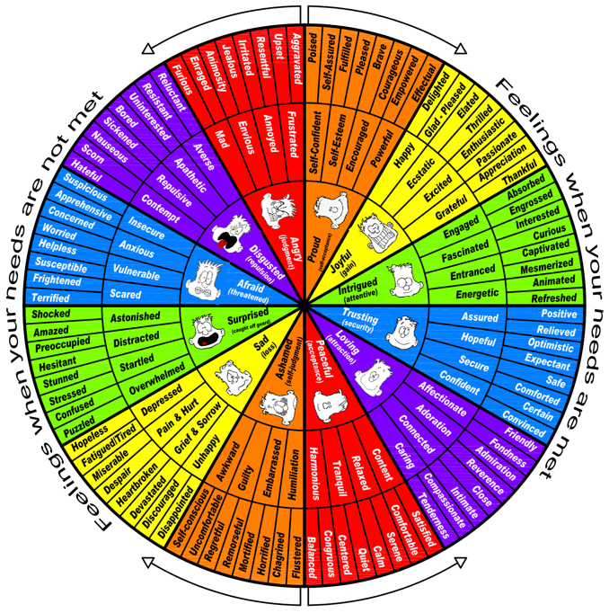
Share and Empathize
*Are you ready to share your story? Not everyone will be ready to share yet.
*Listen, Connect, and Applaud
*Which stories can you relate to?
*How does reading your story make you feel?
*How does it feel to empathize?
Home
Read The Rabbit Listened.
Discuss how the rabbit helped Taylor work through a difficult situation.
Ways to Share
*whole class
*small trusted group
*one on one with a friend
*create a video
*self (journal)
Play “Brave” by Sara Bareilles or other songs from the resource section to motivate students to share their stories.
Next

Slide 9
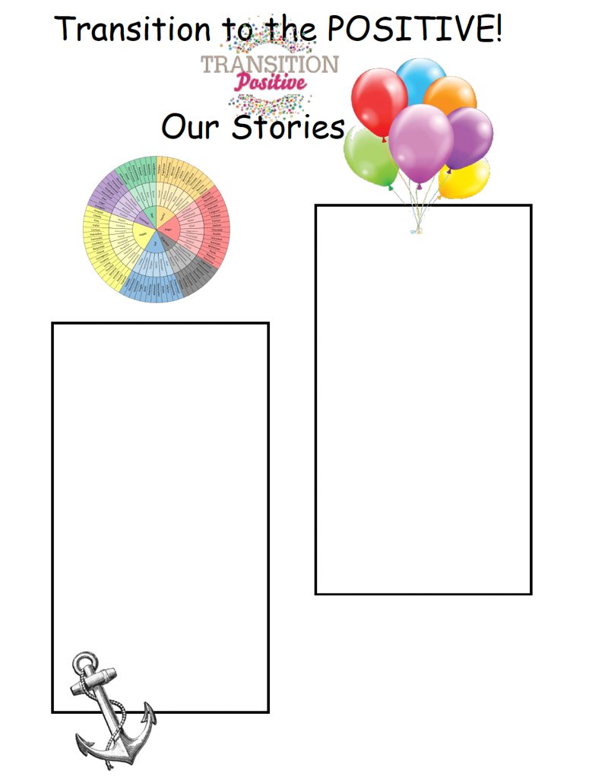
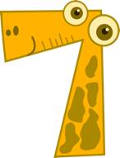

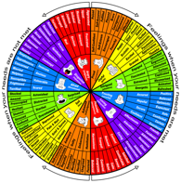
Hope Into Action
Home
What is the challenge from your Imagine Story?
What is your hope for a better future?
What is the ending you would like your Imagine Story to have?
What action can you take to make your dream happen?
take action
list hopes
list challenges
5. Change your "Imagine"
dreams into "I” statements.
I am…
I can…
I will…
DO…
*Write down 3 things you will do to bring your hopes and dreams to life.
*Make a poster to show your
commitment to your achieving
your dream.
*Watch the story, Dream Big, by Deloris Jordan. Discuss what actions Michael took to make his dreams come true.
Next

Slide 10

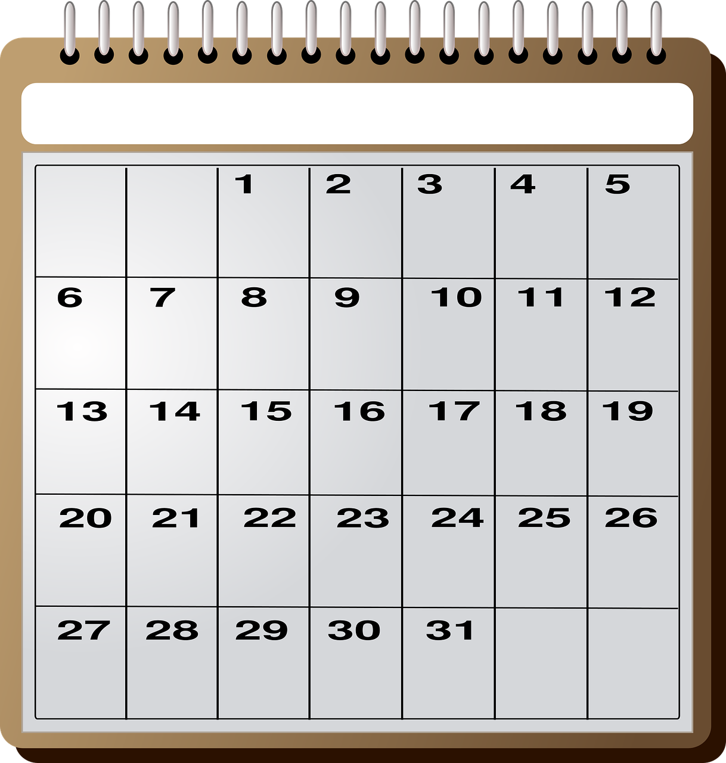
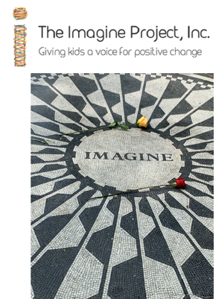
Home
Take the 30 Day Imagine Challenge!
Every day for the next 30 days, take a few minutes to write at least:
3 things you want to Imagine happening in your life
3 things you are grateful for in your day (big or small)
1 act of kindness you have done or plan to do to a stranger, friend, or family member.
You will develop a new habit of setting goals, being grateful and acting kind.
Day 1 ♥
Imagine…
Imagine…
Imagine…
I am grateful for…
I am grateful for…
I am grateful for…
Kind Act…
♥
♥
♥
♥
♥
♥
♥
♥
♥
♥
♥
♥
♥
♥
♥
♥
♥
♥
♥
♥
♥
♥
♥
♥
♥
♥
Read the story, Byron the Caterpillar Who Loved to Imagine! By Dianne Maroney. What was Byron grateful for? Where did the act of kindness happen in the story?
♥
♥
♥
♥

Slide 11
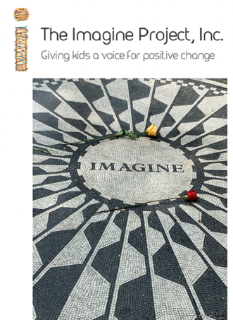
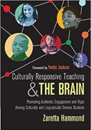
Home
Culturally Responsive Teaching and The Imagine Project
for the teacher…
Imagine all students invited to be seen and heard in your classroom.
Imagine setting your classroom norms around the Four Agreements of Courageous Conversations.
Imagine students accepting and expecting to be engaged, experience discomfort, speak their truth, and non-closure.
Imagine using the four agreements to frame all the discussions and sharing in your classroom.
Imagine using the Six Themes of Culturally Responsive Teaching to drive your planning for instruction.
Imagine exploring each of the themes through literature and The Imagine Project.
Imagine your classroom becoming equitable for all students regardless of their backgrounds, cultures, or experiences.
Imagine The Imagine Project playing a central role in your equity work.
Professional Development Resource
Culturally Responsive Teaching and The Brain: Promoting Authentic Engagement and Rigor Among Culturally and Linguistically Diverse Students by Zaretta Hammond
Next

Slide 12
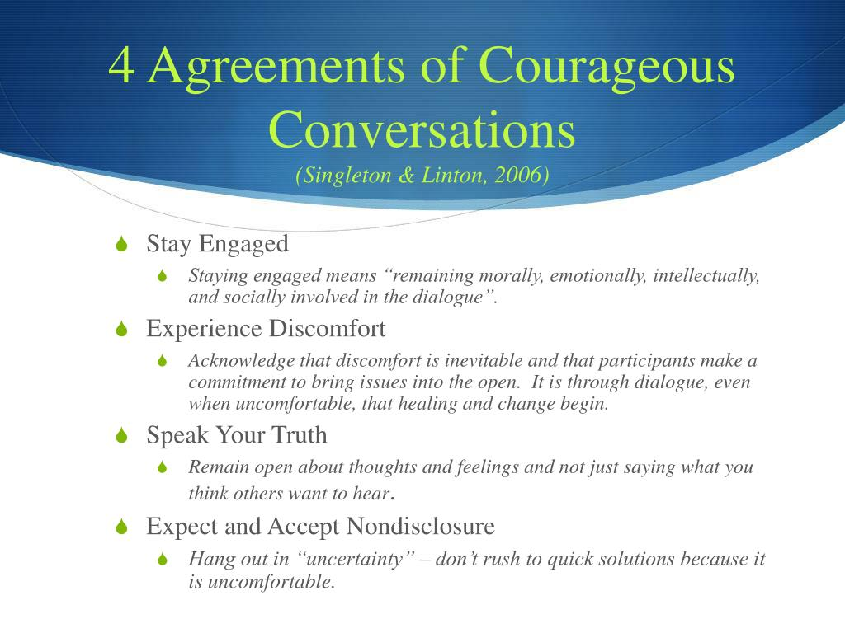
Home
for all classrooms
Next

Slide 13
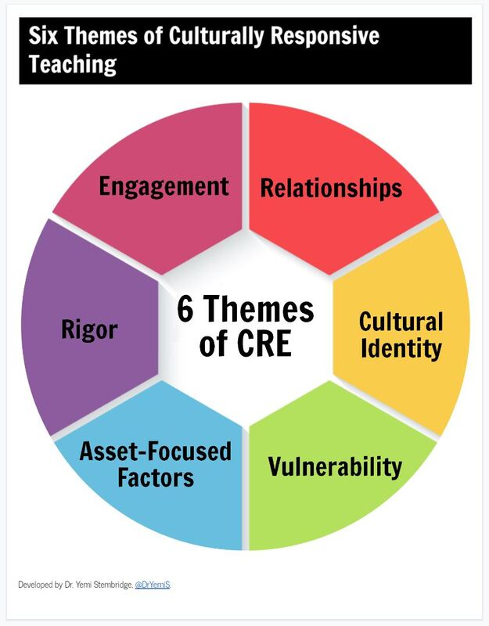
Home
Imagine Friendship…
Imagine character traits around how you are as a friend
Imagine a problem that has happened with a friendship
Imagine what could come of this problem if it could be solved (how could this problem be a good thing)
Imagine Learning…
Imagine things you like and dislike about school
Imagine how you feel at school and why
Imagine what you could do/ or your teacher could do to change the things you dislike
The Invisible Boy by Trudy Ludwig
Each Kindness by Jacqueline Woodson
Imagine Challenge…
Imagine something that is really hard to accomplish.
Imagine the feelings as you struggled.
Imagine what would happen if you never gave up.
Imagine Culture…
-traditions
-family
-values
-beliefs
-language
Imagine.. What do you do/ how do you do it/ with whom
Trying by Kobi Yamada
A Different Pond by Bao Phi
Imagine Strengths…
Imagine something that you worked really hard to achieve.
Imagine the feelings
Imagine what you are known for and that you are proud of. How did you accomplish it.
Imagine Sharing…
Imagine sharing something people don't know about you
Imagine the feelings that go along with this
Imagine the best things that could come out of people knowing this about you.
The World Needs Who You Were Made to Be
by Joanna Gaines
Ruby Finds a Worry by Tom Percival

Slide 14
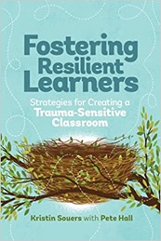
Home
Social Emotional Learning and The Imagine Project
for the teacher…
Imagine students coming to school not ready to engage in learning.
Imagine students not being able to access their “upstairs/wizard” brain because they are stuck in their “downstairs/lizard” brain.
Imagine students stuck in their fight, flight, or freeze mode while you are trying to teach content.
Imagine putting routines in place where students can regulate themselves before starting to learn.
Imagine playing the GRIT Game to help students to regulate physically, mentally, emotionally, and socially.
Imagine using The Imagine Project to help students relate to each other.
Imagine that after students are invited to regulate and relate that they are prepared to reason and learn.
Imagine using these tools on a regular basis to prepare students for learning.
Imagine your students developing resilience and grit because you invested in preparing their brains for learning.
Professional Development Resource
Fostering Resilient Learners: Strategies for Creating a Trauma-Sensitive Classroom
by Kristin Souers and Pete Hall
Next

Slide 15
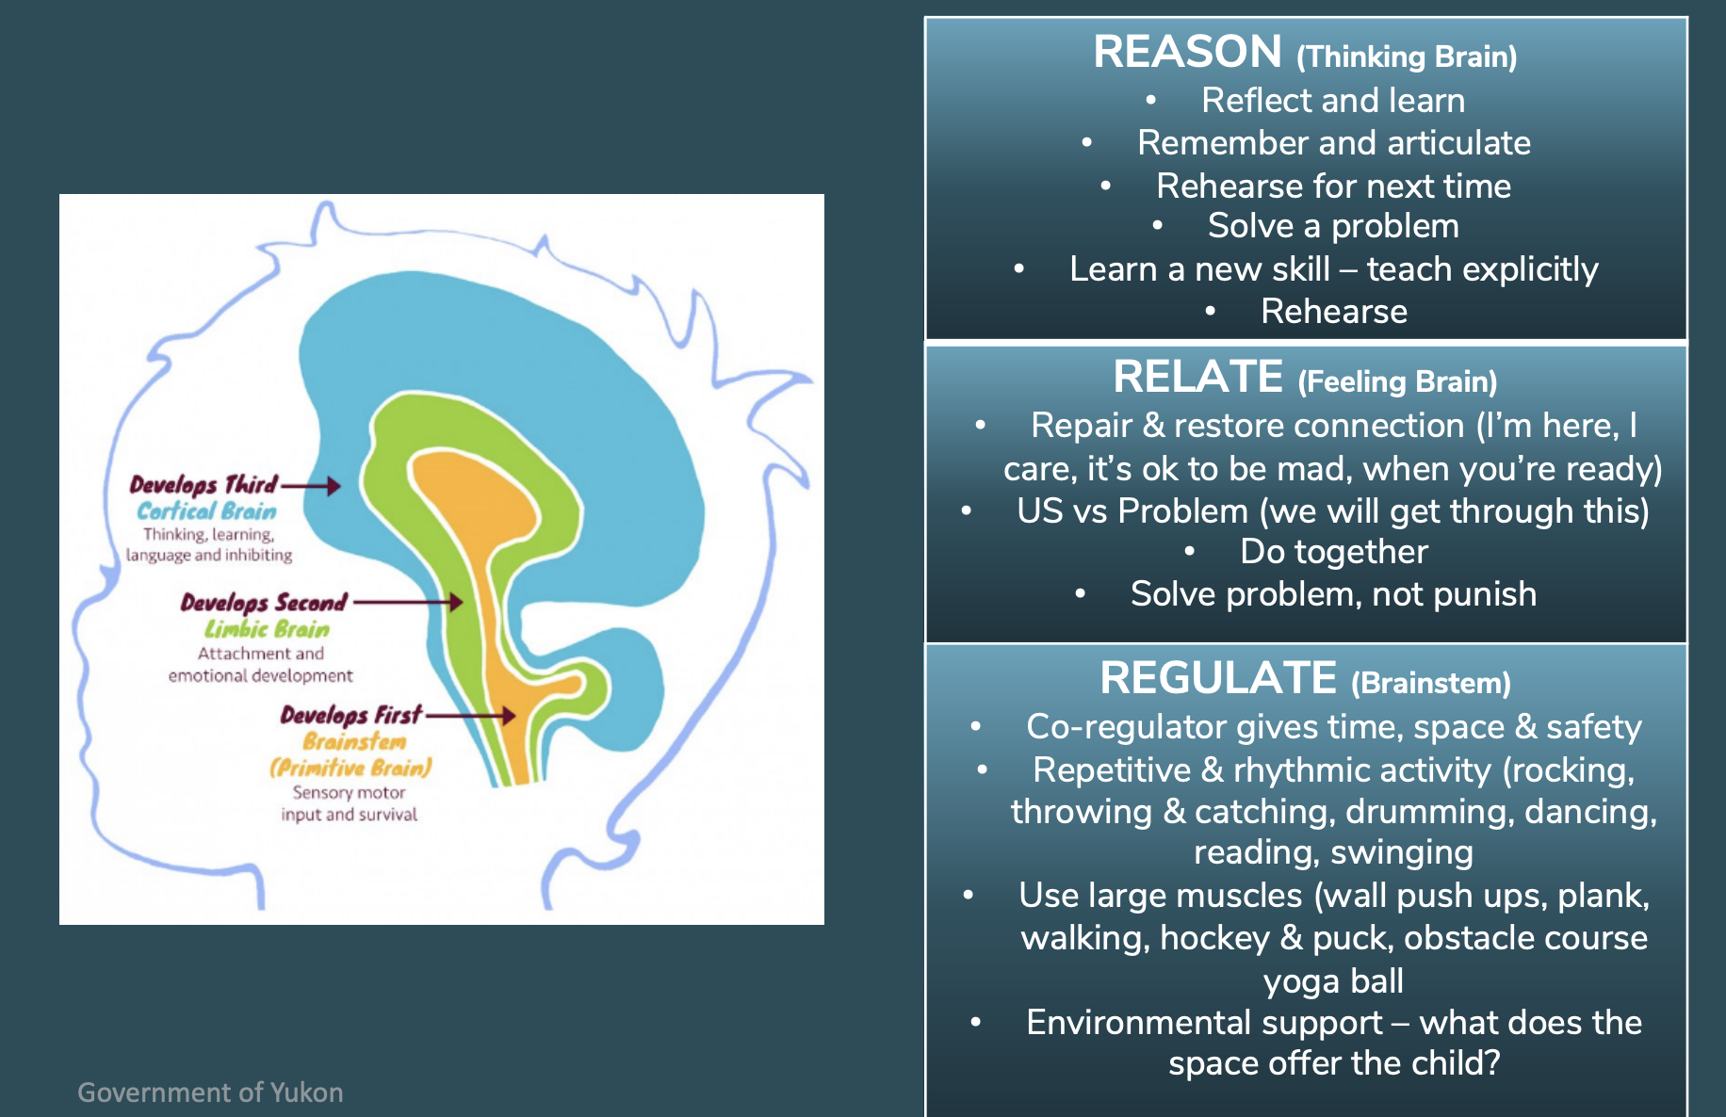
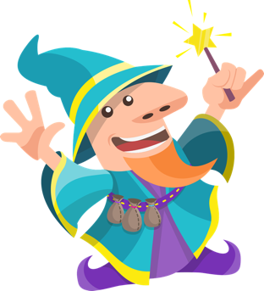

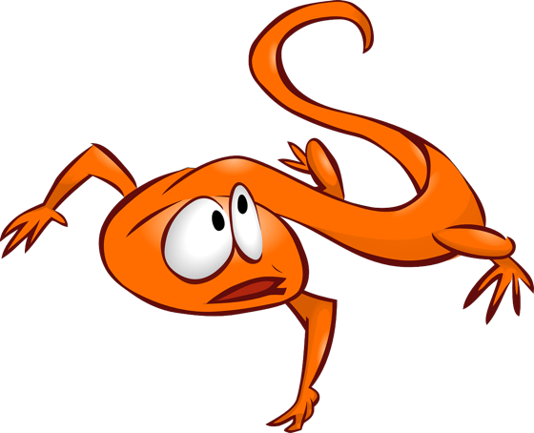
Home
Upstairs/Wizard Brain
Ready to Reason and Learn
Downstairs/Lizard Brain
Fight, Flight, and Freeze
Next

Slide 16
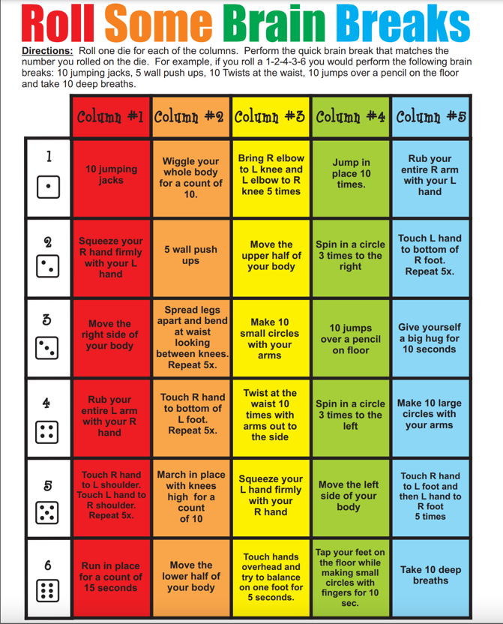
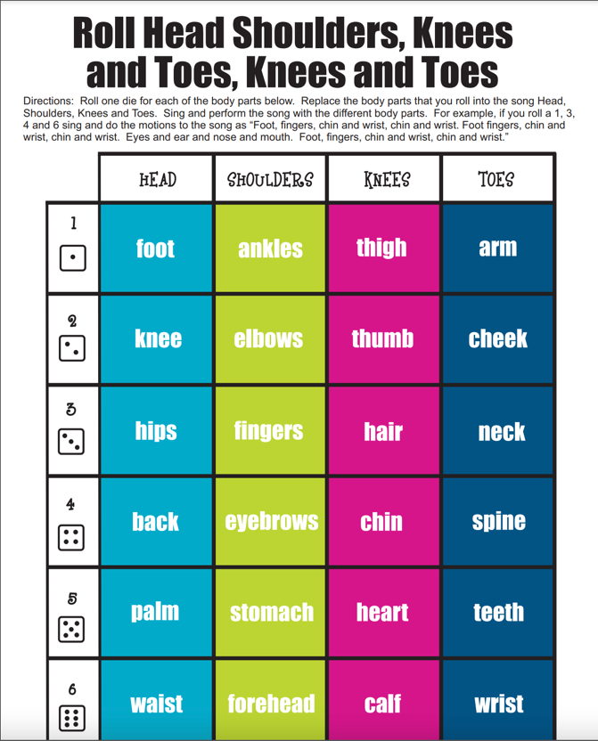
Play the GRIT Game
Resilience - the ability to recover quickly from difficulties; toughness.
Grit - courage and resolve; strength of character.
Home
Physical movement:
Roll some dice and follow the directions to get moving.
What do you do when you experience life’s frustrations?
How do you regulate?
Next

Slide 17
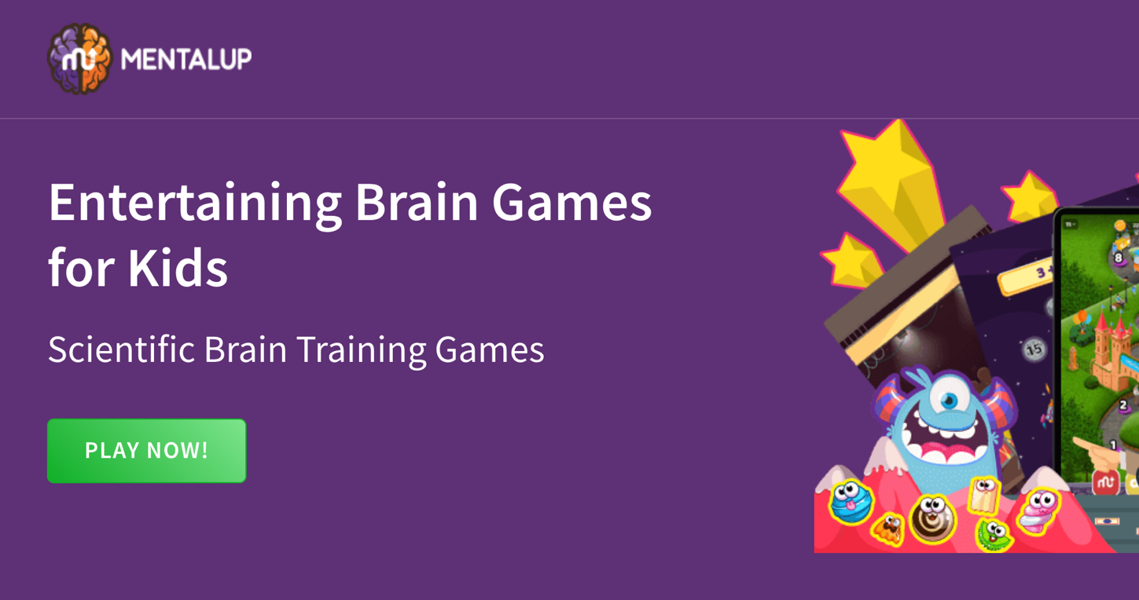
Play the GRIT Game
Home
2. Mental stimulation:
Click “Play Now!” and choose a brain game to play.
-How does it feel to play a brain game?
-Was it frustrating? How did you get better?
Next

Slide 18
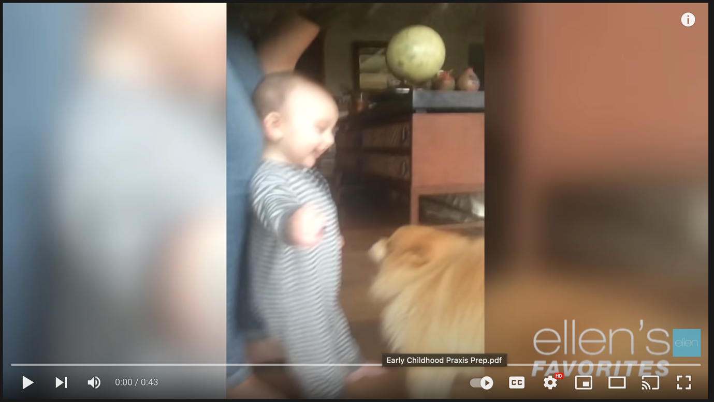
Play the GRIT Game
Home
3. Emotional:
Watch the video and try not to giggle.
-What makes you laugh the most?
-Why is it important to express your emotions?
Next

Slide 19
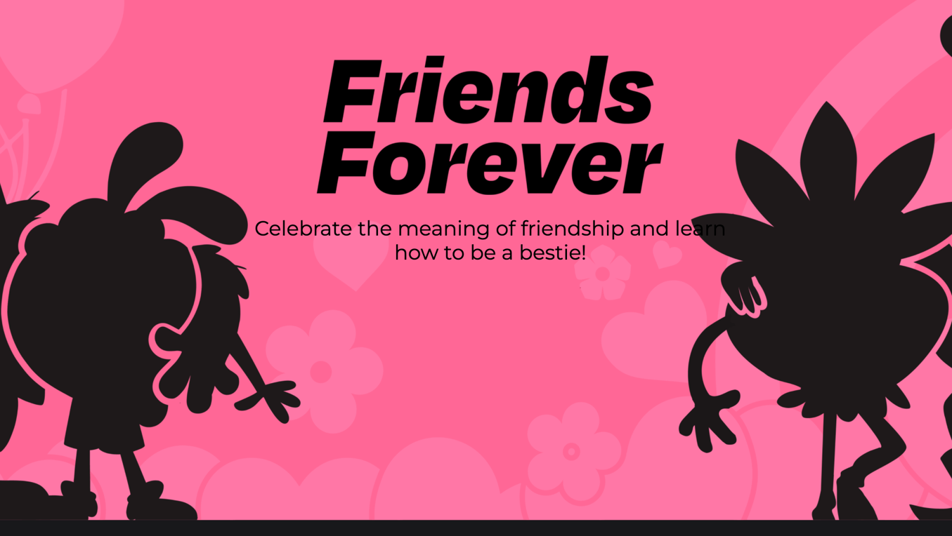
Play the GRIT Game
Home
4. Social:
Click on “Friends Forever” and explore what makes a good friend.
What does it take to make a good friend?
Next

Slide 20
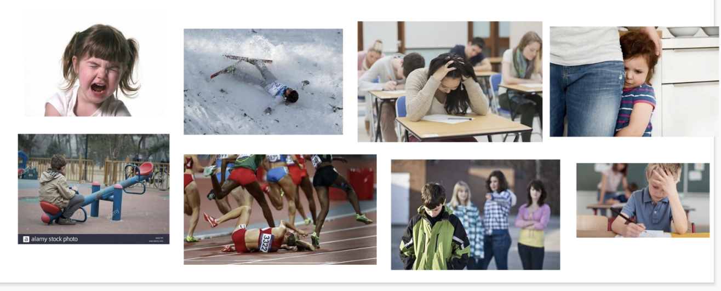
Play the GRIT Game
Home
What type of GRIT do you need in each of these situations?
Physical?
Mental?
Emotional?
Social?
Read Malala’s Magic Pencil by Malala Yousafzai
*How does Malala use all four types of grit in her life?

Slide 21
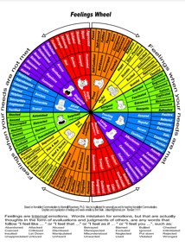
Home
Exploring Emotions and The Imagine Project
for the teacher…
Imagine coming to school with strong emotions flowing through your mind and body.
Imagine knowing that you are feeling something but not knowing how to describe it.
Imagine a tool that can help you provide words for your emotions.
Imagine the Feeling Wheel expanding your students’ vocabulary as they explore their feelings through The Imagine Project.
Imagine learning to expand the feeling words into descriptions that show what it is like to experience that emotion.
Imagine helping students expand their understanding of what they are feeling and what feelings they see in others.
Imagine using the Feeling Wheel to not only explore personal emotions but to also explore the character traits of fictional and historical characters throughout the curriculum.
Professional Development Resource
Download The Feeling Wheel:
https://ytp.uoregon.edu/sites/ytp2.uoregon.edu/files/Feelings%20Wheel%20in%20PDF.pdf
Next

Slide 22



Home
SHOW don’t tell EMOTIONS
Step 1. Identify a challenging experience.
Generate ideas as a class.
“A time when I felt sad/scared/worried was __________.” “I felt this way because ____________.”
“How did this make me feel? Name the emotion.”
Collect emotions as a class.
Next

Slide 23





Home
SHOW don’t tell EMOTIONS
Step 2: Model “Showing, Not Telling.”
*What does your face look like when you’re feeling ________________?
*What does your body do when you’re feeling ______________________?
*What do you say when you’re feeling _____________________________?
*Where do you go when you’re feeling this way? Describe the setting or draw it.
Practice with different feelings.
Next

Slide 24
Home
SHOW don’t tell EMOTIONS
This may transfer to the imagine story like this:
Imagine the bullies
Imagine their laughter as you walk past them Imagine the sadness
Imagine the tears rolling down your red cheeks Imagine your shoulders slumping
Imagine asking, “Why are they so mean?”
Imagine lying on your bed snuggling beneath your blue and white blanket Imagine grasping your only friend--Mr. Cuddles, your favorite stuffed animal.
Step 3. Transfer ideas to an imagine story.
Emotion: Sad
Face: Tears rolled down my red cheeks
Body: My shoulders slumped
Say: Why are they so mean?
Where: I like to lie on my bed and snuggle beneath my blue and white blanket grasping my brown teddy bear, Mr. Cuddles.
Next

Slide 25
Home
SHOW don’t tell EMOTIONS
Imagine making new friends. Imagine a smile spreading across your face.
Imagine standing tall knowing you’re not alone. Imagine saying, “Mom! I’ve made new friends!”
Imagine playing with your new friends on the playground. Imagine slipping down the slide laughing like a hyena.
Step 4: Action Plan:
*How did you show grit and resilience? (Ask students to review ways to show resilience)
*What can you do to make yourself feel better?
*What is your solution?
Your hopes?
How did this action plan change your feelings?
Name the emotion.
SHOW IT!
FACE:
BODY:
SAY/THINK:
SETTING: Where do you go when you’re feeling this way? Describe the setting or draw it.
Now continue your Imagine Story, but focus on resilience and the positive emotions.

Slide 26
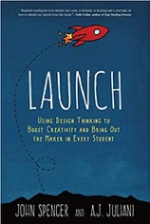
Home
The Design Cycle and The Imagine Project
for the teacher…
Imagine your students applying The Imagine Project to design creative projects that make their world a better place.
Imagine identifying a personal, classroom, school, or worldwide problem to be solved .
Imagine exploring that problem and processing your feelings about it through an Imagine Story.
Imagine your students asking questions and researching everything they can about their problems.
Imagine the hopeful turn in your Imagine Story becomes the solution for your problem.
Imagine your students designing tangible, actionable solutions and presenting them to the world.
Imagine all the Imagine Stories your children write are examples of hope waiting to be launched.
Professional Development Resource
Launch: Using Design Thinking to Boost Creativity and Bring Out the Maker in Every Student
by John Spencer
Next

Slide 27
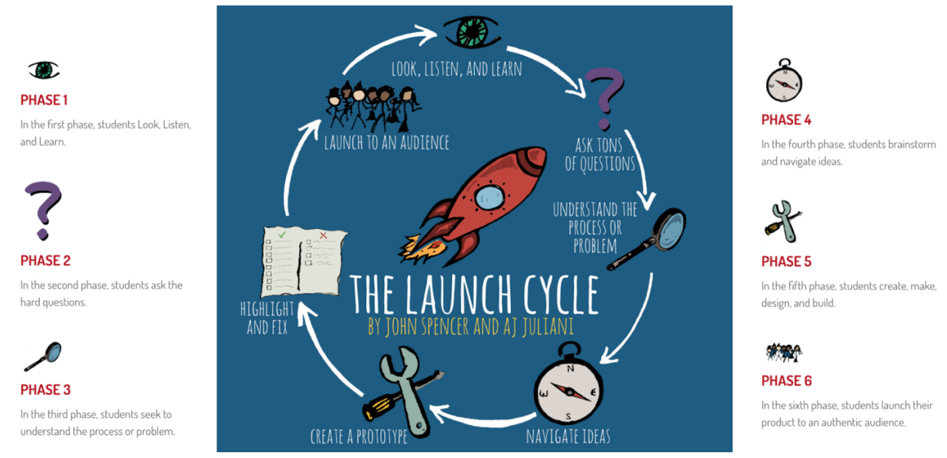
What would you change about your world?
Home
Imagine your problem?
Imagine the solution in action
Imagine who, what, where, and how it impacts
Imagine creating your solution
Imagine what more you need to know about it
Imagine sharing your creation with your world
Next

Slide 28






Home
Get to know your problem
Brainstorm problems, challenges, and struggles that are happening in your world.
Choose one that you connect with.
Brainstorm questions about the problem so you can understand it better.
Who?
What?
Where?
Why?
How?
What more do you need to know? What research do you need to do?
Write the beginning of your Imagine Story showing your problem clearly.
Next

Slide 29



Home
Create your hopeful solution
Brainstorm different ways that the problem could be solved.
Imagine what your world would be like when the problem is solved.
What can you create that would help others with this same problem?
What actions can you take that would solve this problem?
Write the hopeful ending to your Imagine Story showing how the world is better with your creation.
Share your story and creation with the world.

Slide 30
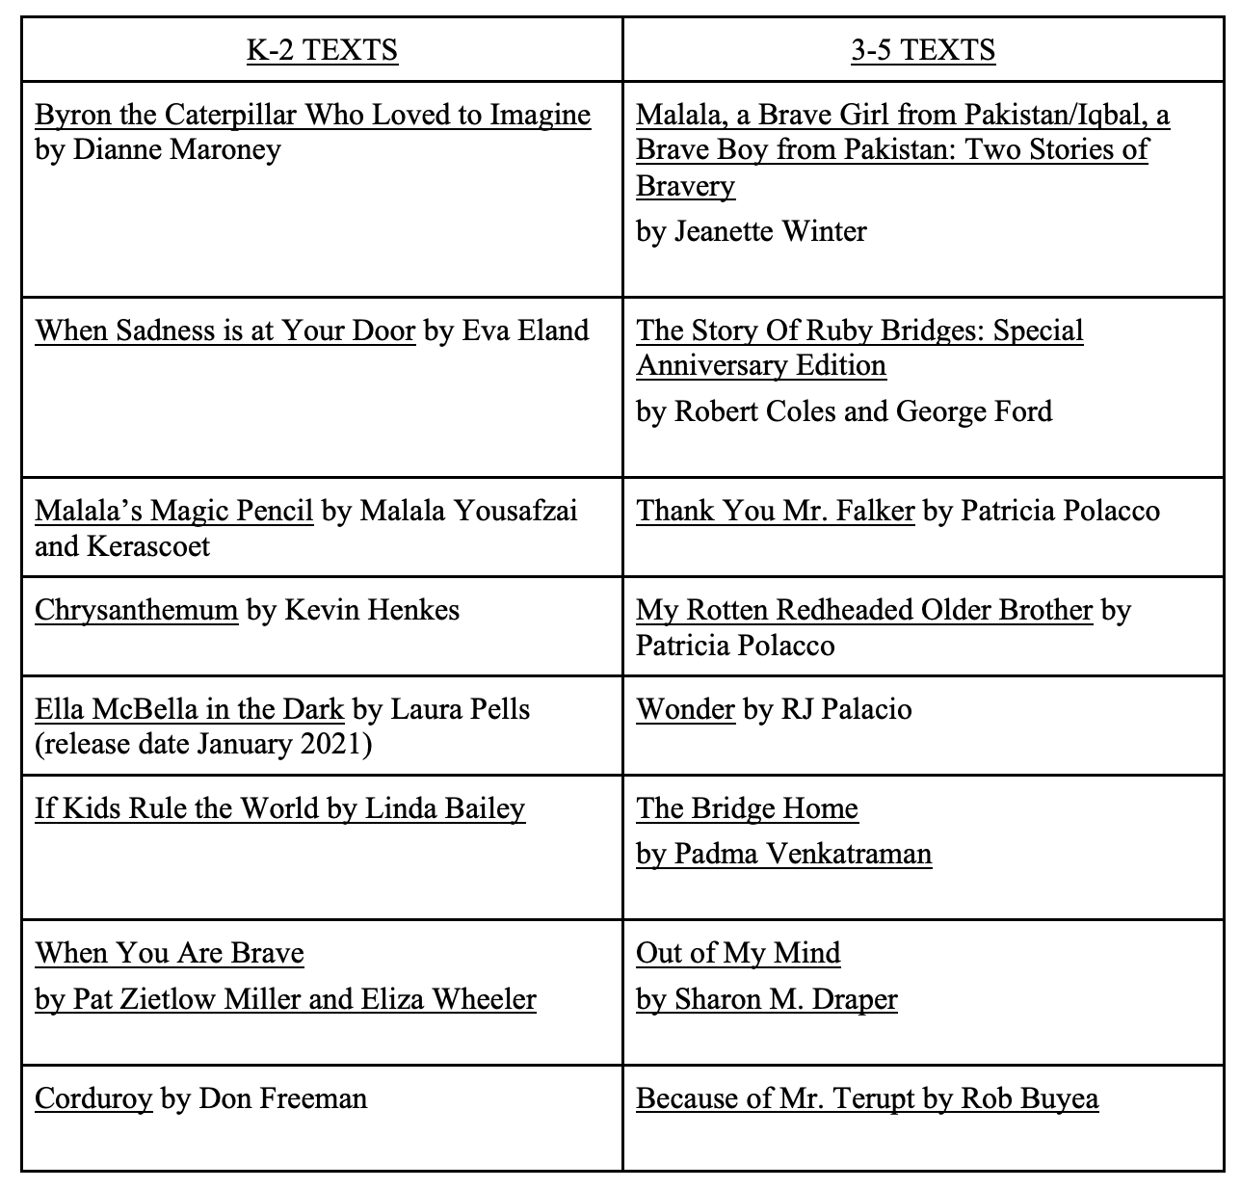

Home
Next

Slide 31
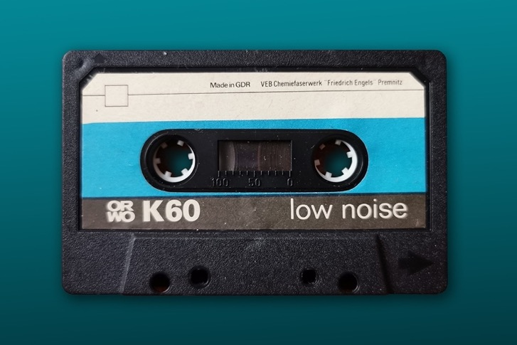
Home
“Roar” by Katy Perry
“The Climb” by Miley Cyrus,
“Life is Worth Living” by Justin Bieber,
“Fly” by Maddie and Tae
“I Love this Life” by Locash
“Imagine” by John Lennon
“Humble and Kind” by Tim McGraw
“Roll up Your Sleeves” by Meg Mac
“Lovely Day” by Bill Withers
“Sideways” by Travis Meadows
“Be Yourself” by Seth Alley
“Fly” by Maddie and Tae
“Into Dust” by Mazzy Star
“Lean on Me” by Bill Withers
“Renegades” by X Ambassadors
“Beautiful” by Christina Aguilera
“Story of my Life” One Direction
“Three Little Birds” by Bob Marley
“Just Imagine It” by MKTO
“Rise Up” by Audra Day
“Brave” by Sara Bareilles
“Fight Song” by Rachel Platten
Imagine Project Mixtape
Next

Slide 32


Write an imagine story…
Home
Malala's Imagine Story
Imagine… being targeted every time you try to attend school just because you are a girl.
Imagine… having to ride to school on a bus just because it is too dangerous to walk.
Imagine… being shot and attacked on that bus because you believe in the right for girls to be educated.
Imagine… being flown on many different vehicles to many different hospitals because strangers want to save you.
Imagine… waking up in a hospital after surviving a gunshot wound you should have died from.
Imagine… bringing inspiration to millions of people around the world including girls who want an education.
Imagine… giving a speech for all the world to hear. Imagine… being the youngest person to win the Nobel Peace Prize.
…from the point of view of a fictional or historical character .
…at the beginning of a challenging math or science unit to explore the skills you already have and what you hope to learn.
…to explore how fictional or historical characters change. Use the feeling wheel to identify character traits.
…to explore how a piece of art or music makes you feel.
…before you learn a new game or sport.
…from the perspective of someone you disagree with to better understand them.
…anytime you need to understand yourself, your feelings, or others better.
Cross
Curricular
Connections

