Slide 1
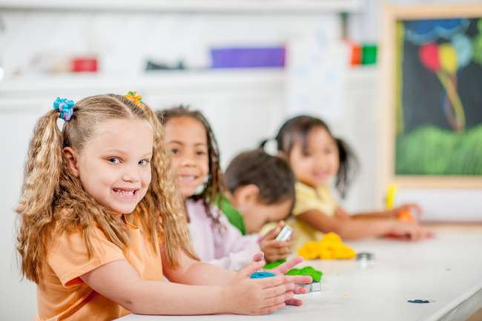
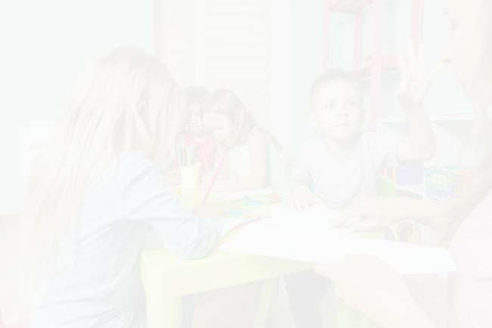
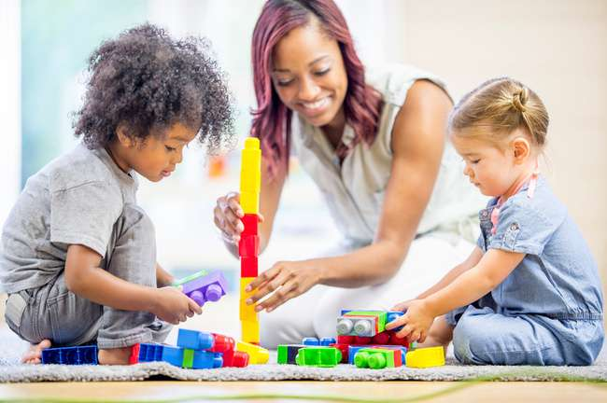
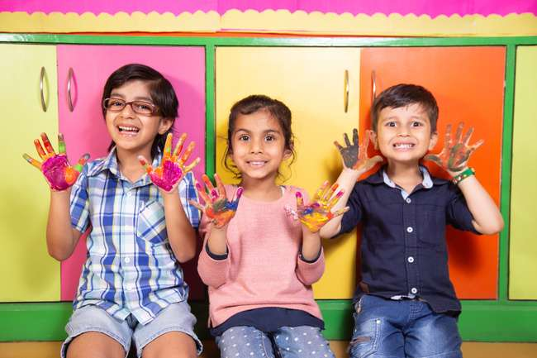
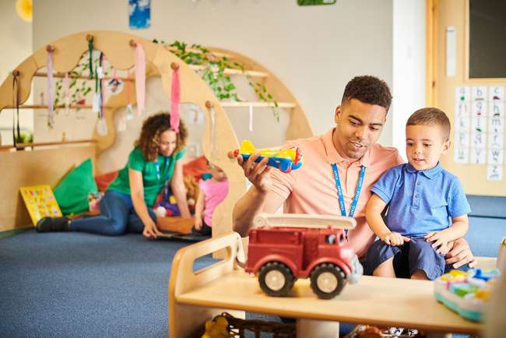
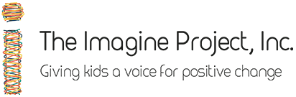
The Imagine Project
Go at your own pace, We encourage you to write your own story when it’s suggested. Writing your own story helps with understanding the power of the project. You will enjoy it, we promise!

Slide 2
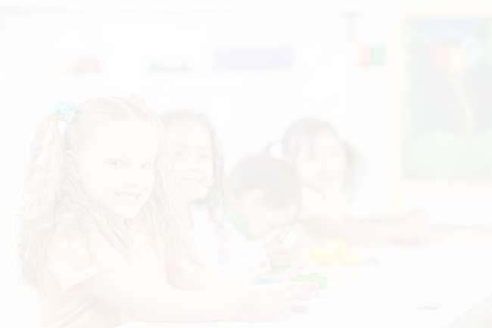

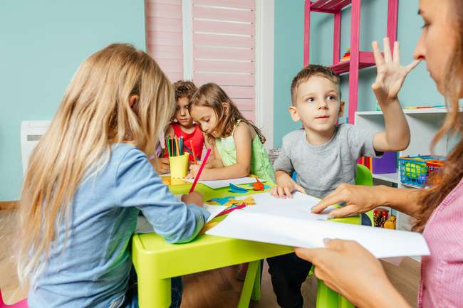
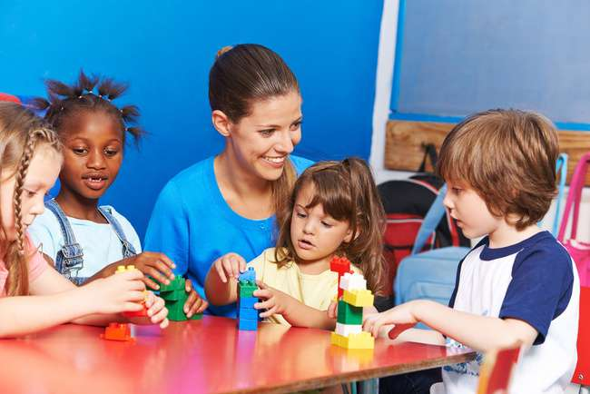
Module 1:
Introduction to The Imagine Project

Slide 3
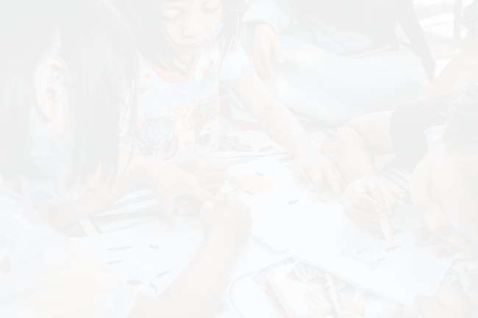


Introduction Video

Slide 4
Dianne’s Personal Story

Slide 5
How and why The Imagine Project started

Slide 6
Getting started

Slide 7
The Feelings Wheel
Use The Feelings Wheel while writing or having others write their Imagine stories.
Download the Feelings Wheel

Slide 8
Module 2:
WHY The Imagine Project?
Learning about Stress and Trauma

Slide 9
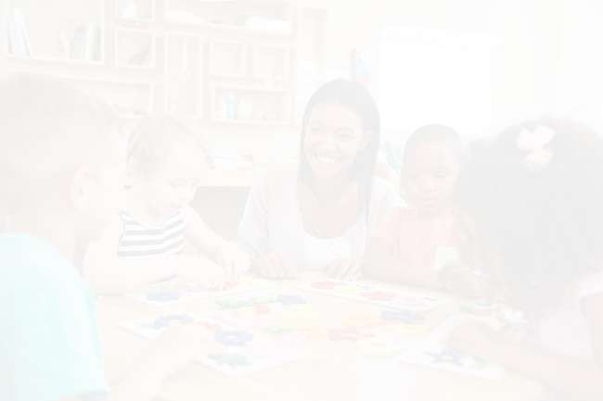

Learning about stress and trauma:
Unfortunately, our world is stressed. Adults are stressed and so are kids. Depression and anxiety are higher than ever before–no matter what age. Research has shown that traumatic events affect 50% of children before the age of 17. Adults and children need tools to mitigate stress and help navigate through challenging life events.

Slide 10

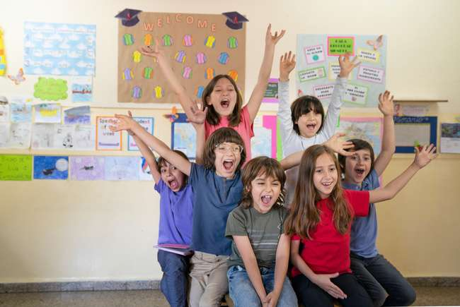

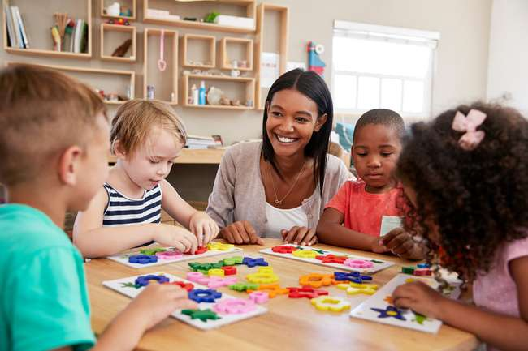
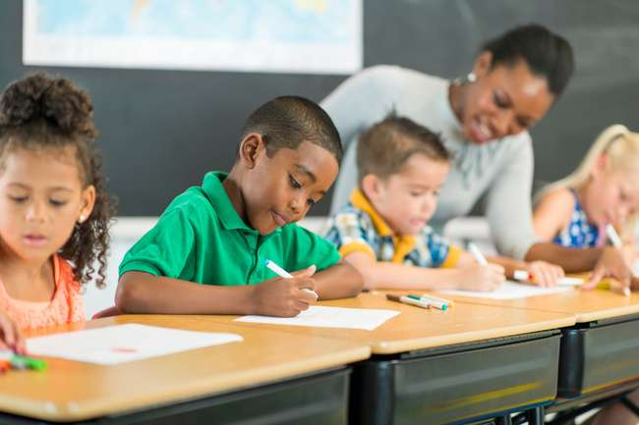
Stress statistics:
    In the last 6-7 years there has been an unprecedented spike in anxiety and depression in adolescents.
    ~35% of children experience health-related stress problems.
    ~10% have anxiety, ADHD, or behavioral problems. ~5% suffer from depression.
    American teens rate their stress at a 5.8 (10 point scale), adults are typically 3.8.
    7 out of 10 teens say anxiety and depression are a major problem among their peers.

Slide 11
Learn about how stress and trauma can show up in kids

Slide 12
  Stomach aches
  Frequent headaches
  Acne
  Dizziness
  Bowel problems
  Bedwetting
  Frequent colds or illnesses
  Becoming clingy
  The quality of school work has changes
  New habits such as hair twirling, nose picking, or thumb sucking
  A change in sleep patterns
  Mood swings
  A child might begin to lie
  Changes in eating habits
Signs of stress:

Slide 13
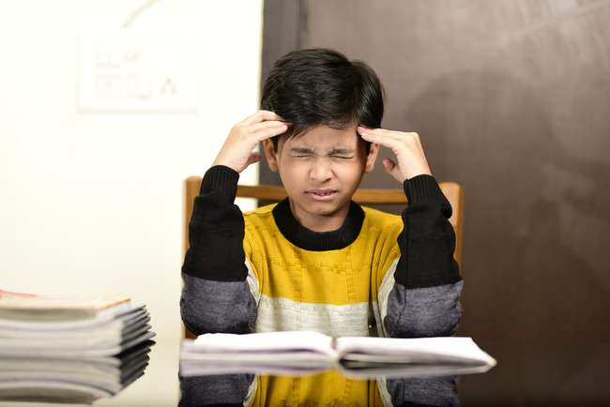
Stress and trauma can:
    Change brain function which will impair a child’s ability to focus, organize, and process information.
    Adversely affect attention, memory, and cognition.
    If a child seems chaotic, unable to focus, easily distracted or frustrated they could be experiencing (or have experienced in the past) some level of stress or trauma.
    Recommended reading if you’d like to learn more about stress and trauma: “What Happened to You” by Bruce Perry, and/or “The Deepest Well” by Dr. Nadine Burke-Harris

Slide 14
Understanding trauma

Slide 15
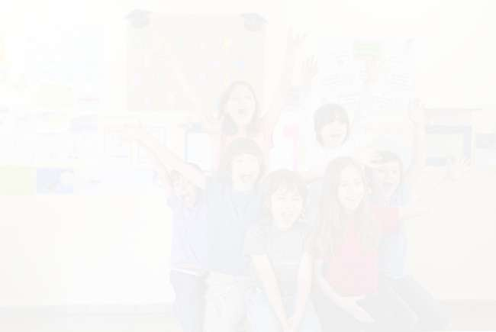
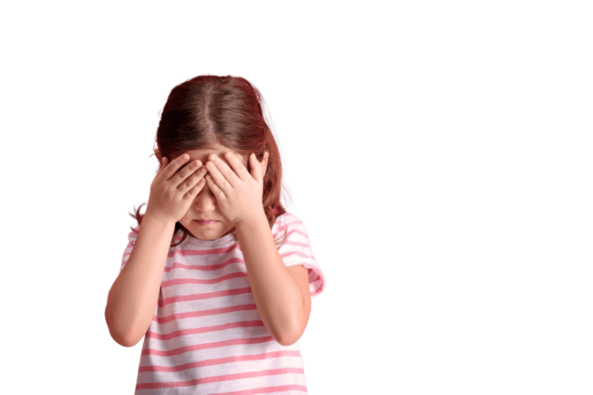
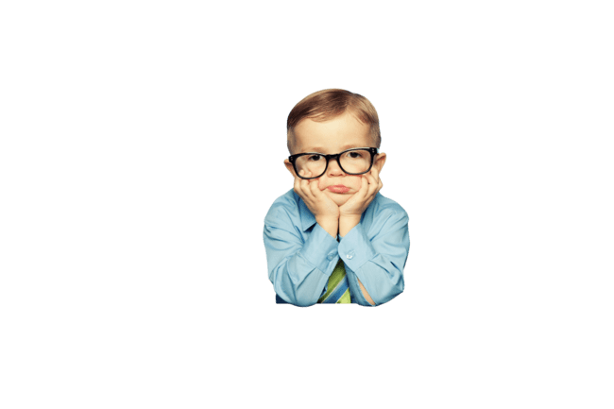
Trauma is any life experience that overwhelms your coping mechanisms. Everyone’s coping mechanisms are different. One child might handle an experience better than another. One child might not be bothered much by loud arguing, another will be very upset. Children are more easily and more profoundly affected by a traumatic event. Traumatic events can be severe or mild depending on the child’s ability to cope.
Click here for a wonderful PBS series talking about trauma and what educators can do in the classroom.

Slide 16
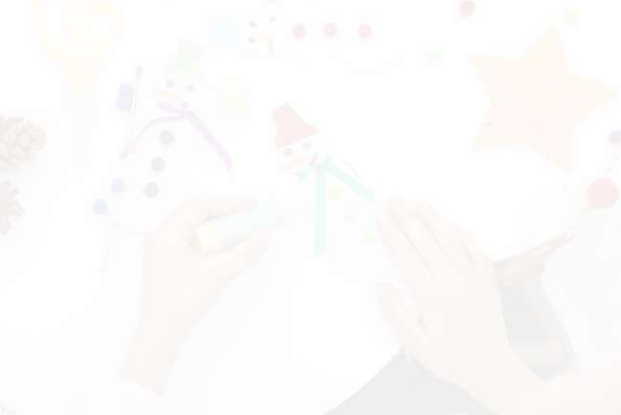
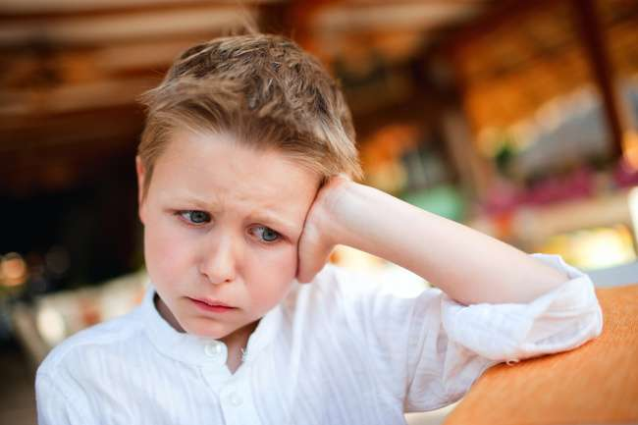
Trauma statistics:
    60% of adults report experiencing some level of trauma
    50% of children experience at least 1 trauma event before the age of 17
    26% of children witness or experience trauma before the age of 4

Slide 17
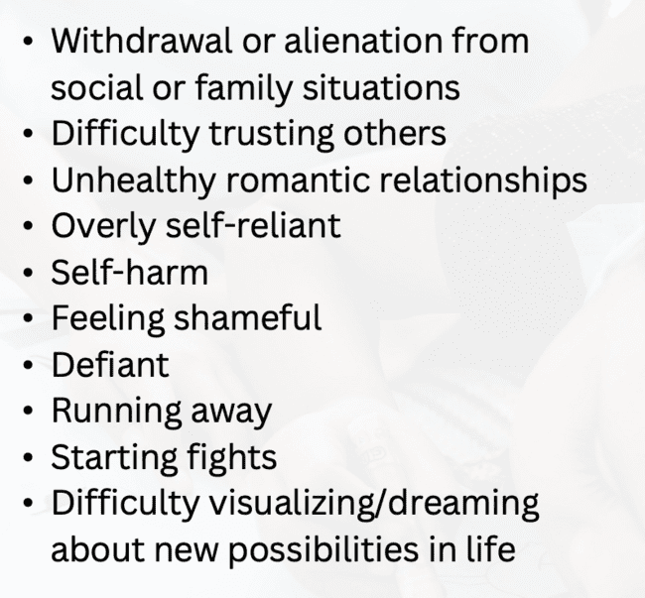
Symptoms of trauma:
  Sleeping or eating problems (hoarding or avoiding food)
  Excessively angry, aggressive, or abusive towards others
  School problems
  Frequent headaches, stomach aches or other physical problems
  Nightmares
  Poor self-confidence/self-esteem
  Addiction: food, drugs, technology, etc.
  Sexual knowledge beyond the child’s age
  Abnormal fears and anxiety
  Suicidal thoughts

Slide 18
Why Does The Imagine Project work?
Dr. Jerry Yager

Slide 19
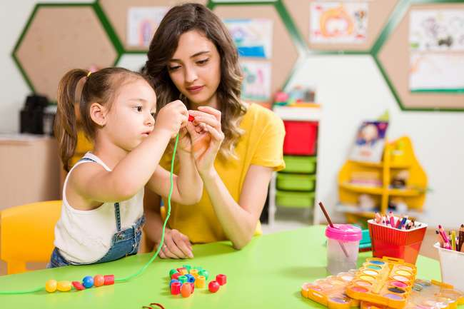
TASK-
take the ACE survey for yourself http://traumadissociation.com/ace

Slide 20
Module 3:
What is The Imagine Project?

Slide 21
What is The Imagine Project?

Slide 22

Writing Helps Mitigate Stress and Trauma
Research shows that writing about life’s struggles helps to process, heal, and move forward during and after experiencing life challenges. Kids are perfect candidates to use writing as a tool to mitigate stress starting as young as Kindergarten through high school. The Imagine Project is a great tool to prompt kids and teens to write about a difficult life story because the 7-step process uses the word Imagine to begin each sentence. Using “Imagine” is a safety net for the writer. It gives them the opportunity to write about their experience without being pulled into a deep/difficult emotion they might have felt using other writing formats. Step 4 in the writing process prompts the writer to Imagine a new story in place of the old story, helping to Imagine new possibilities in their life. A perfect way to move forward to realize they don’t have to be defined by their story.

Slide 23
Teens Talking About
The Imagine Project

Slide 24
TASK:
Watch 2-3 of the following videos of kids reading their Imagine stories. *A few of these stories might be difficult to watch if you have had similar experiences. Please take care of yourself and if you feel triggered just stop and move on to a different video.

Slide 25
Jay’s Imagine Story (Alternative high school senior)

Slide 26
Kamia’s TIP story (freshman in college who was homeless)

Slide 27
Kailee’s TIP story (middle schooler)

Slide 28
Emily’s TIP story (Alternative high school junior talking about abuse)

Slide 29
Victor’s TIP story (Adult talking about using The Imagine Project)

Slide 30
Faith (5th grader)

Slide 31
Kaedon (5th grader)

Slide 32
Molly (5th grader)

Slide 33
Achmed (5th grader)

Slide 34
Chloe (5th grader)

Slide 35
Module 4:
How to Use The Imagine Project

Slide 36
How does The Imagine Project work?

Slide 37
Teacher talking about using The Imagine Project

Slide 38
Middle School Counselor talking about using The Imagine Project

Slide 39
The Imagine Project works with Uplift

Slide 40
Module 5:
Writing Your Story

Slide 41
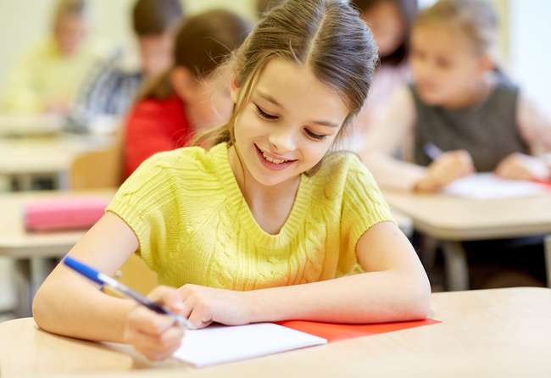
Now it’s time to write using The Imagine Project 7-step process. It’s important to write your own story so you can witness and feel the power and benefit of using The Imagine Project before asking someone else to write.
Download The Imagine Project Journal to begin writing (or you can use your own writing pad if you’d like). Grab a pencil or pen to get started!

Slide 42
Imagine Project Spotify Playlist:
We recommend playing music while you and your students write their Imagine stories. We’ve made a list of songs you can use for each step but feel free to pick your own.
Here is a Spotify playlist you can use while writing your Imagine story and while you’re working with students.
https://open.spotify.com/playlist/3Xyfy02g4oFsJkIPHoL70N?si=e1cd1e67607349f4

Slide 43
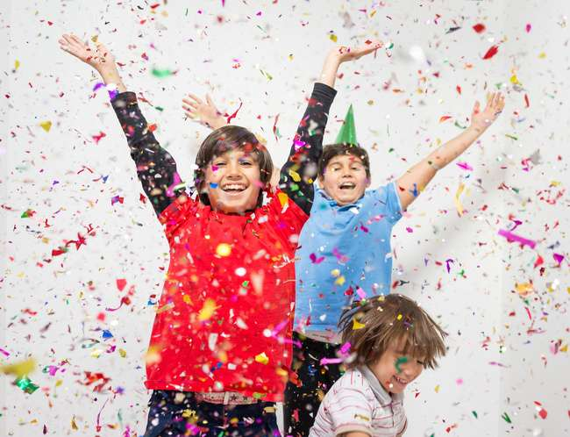
Step 1 – Celebrate:
Task: Make a list of positive experiences that have happened in your life. What are you proud of? What do you love about your life? Connect them to feelings on the feelings wheel when appropriate.
Song suggestions for step 1: “Beautiful” by Christina Aguilera.

Slide 44
Reflect

Slide 45
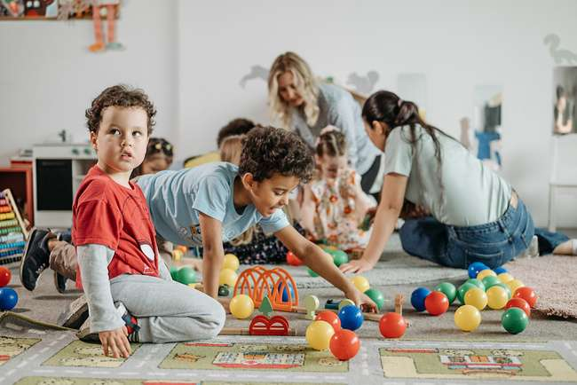
Step 2 – Reflect:
Task: Reflect on difficult times or challenging life experiences related to a specific topic. Write down 1-3 challenging experiences that have happened in your life. They can be yesterday, last year, or in the past. Connect them to feelings on the feeling wheel.
Song suggestion for Step 2: “Story of my Life” by One Direction.

Slide 46
Writing your Imagine Story

Slide 47
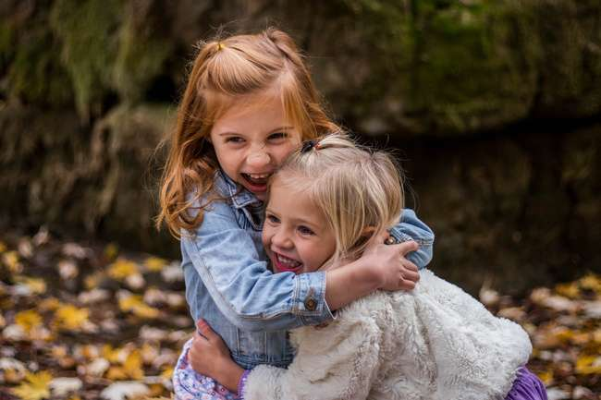
Step 3 – Write your Imagine Story
Task: Write an Imagine Story: Take one of the difficult life experiences from step 2 and write an Imagine story about it. Tell the story beginning each sentence using the word Imagine. Write the story in detail and use feeling words where appropriate. Write your story in second person using, “you”.

Slide 48

  Check The Imagine Project Spotify playlist for possible songs (typically need 2-3 songs for this step). Song suggestions: “Into Dust” by Mazzy Star, “Renegades” by X Ambassadors, “Three LIttle Birds” by Bob Marley

Slide 49
The Hopeful Turn

Slide 50

Task: Share your story.
If you are able, it’s a powerful process to share your story with someone. In a group setting or someone you feel comfortable with. Sharing creates vulnerability but it also is very empowering to feel heard. (Some teachers/leaders wait and share after Step 4)

Slide 51
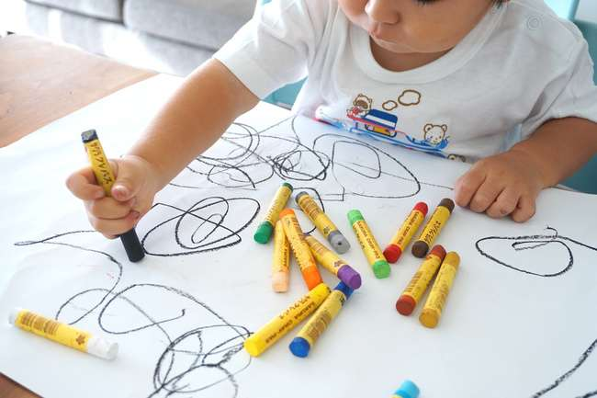
Step 4-Writing the Hopeful Turn
Task: Write a new ending to the story you wrote about in step 3. How do you want the story to end? What’s positive that has, or can come from your story? Write a new ending to your story using the word Imagine to begin every sentence. Use feeling words where appropriate. You can encourage participants to share their story after this step as well.

Slide 52

  Check The Imagine Project Spotify playlist for possible songs. This typically needs 1-2 songs. Song Suggestions: “Just Imagine It” by MKTO, “Can’t Knock Me Down” by Pretty Panther

Slide 53
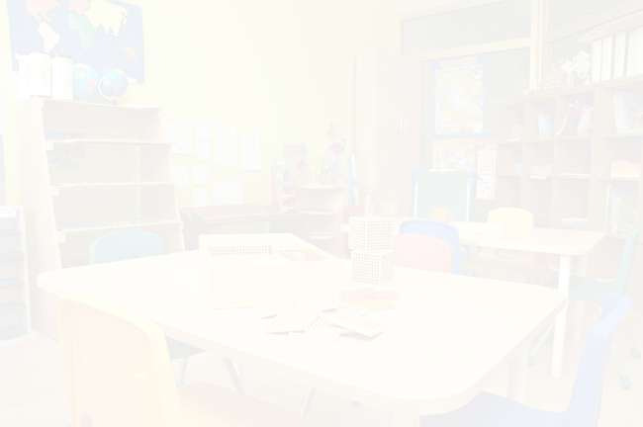
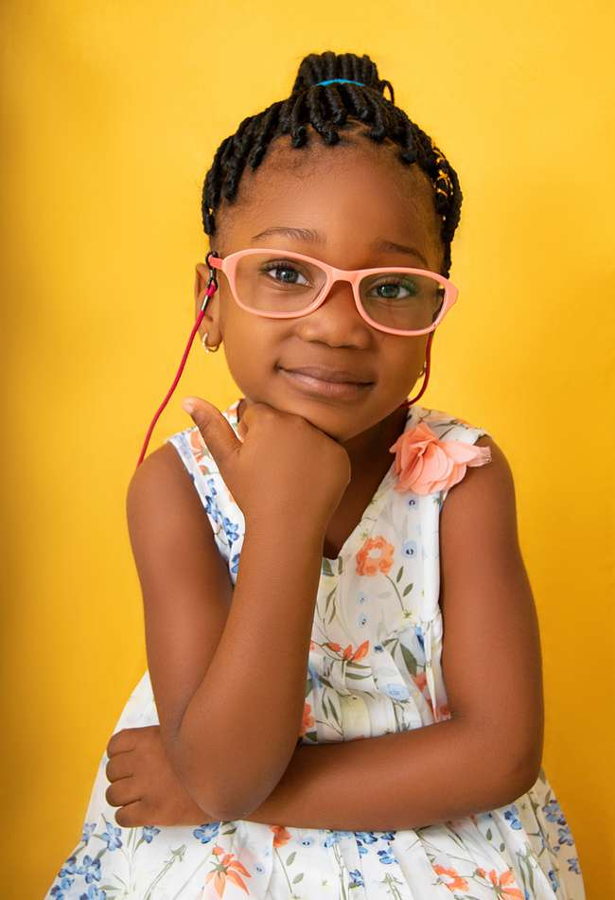
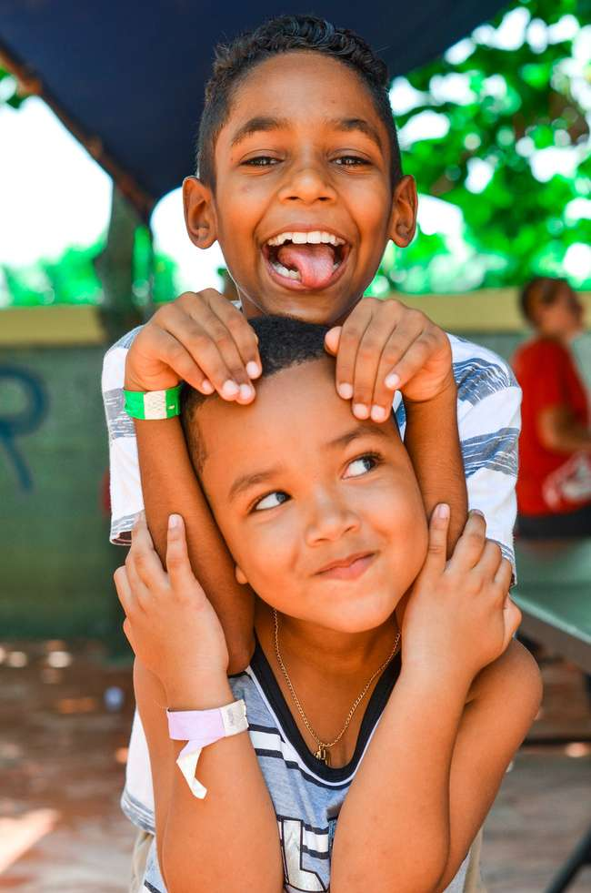

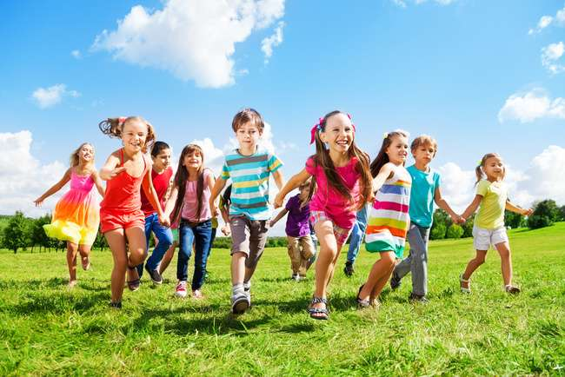
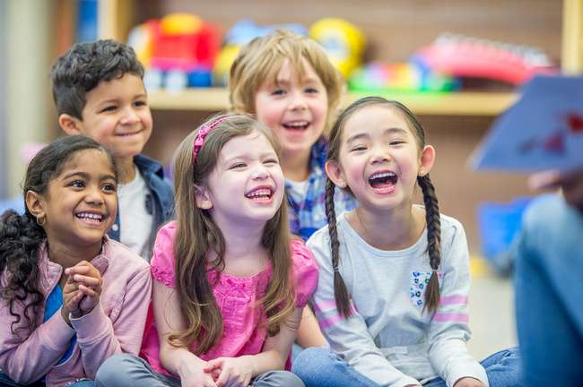
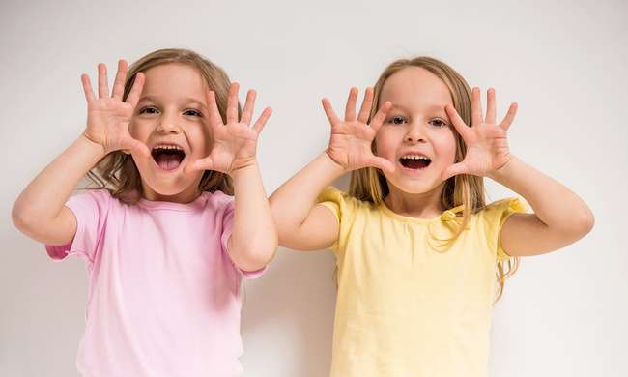
After Step 4 (hopeful turn), it’s a powerful process to share your story with someone. In a group setting, you can share with each other. Sharing creates vulnerability but it also is very empowering to feel heard.

Slide 54
Turning your hope into goals

Slide 55
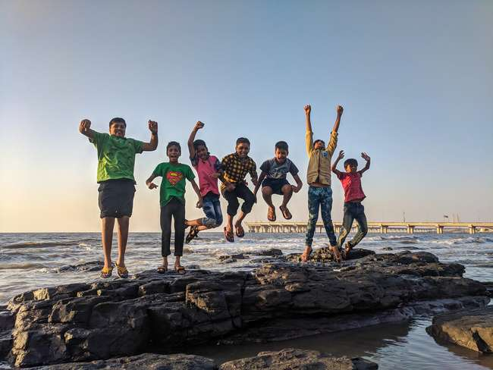
Step 5- I am, I can, I will
Task: Turn your dreams into I statements! Write your Imagine Dreams in I statements; I am, I can, I will…

Slide 56
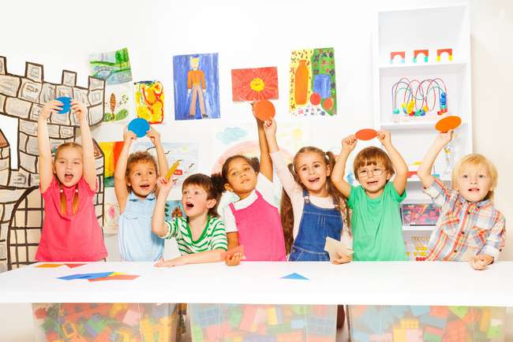
  Check The Imagine Project Spotify playlist for possible songs.This is a fast step, you may or may not need a song. Song suggestions: “Roll Up Your Sleeves” Meg Mac

Slide 57
Taking Action

Slide 58
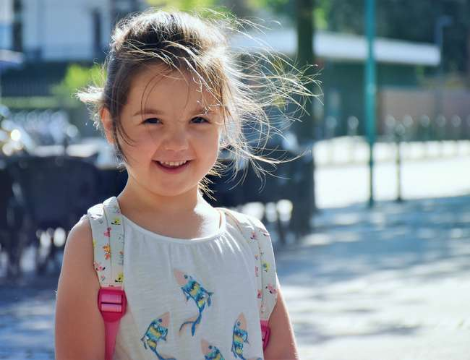
Step 6- DO!
Write down 3 things you need to do to make your dreams happen.

Slide 59
Check The Imagine Project Spotify playlist for possible songs. This is also a quick step, you may or may not need a song. Song suggestions: “The Climb” by Miley Cyrus
TASK- Set Action Goals

Slide 60
330 Day Challenge

Slide 61
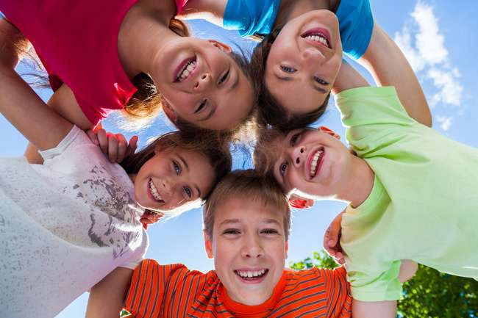
Step 7- 30 Day Challenge
Task: In this challenge you are asked/asking that every day for 30 days you write down 3 things you are grateful for, 3 things you want to Imagine in your life, and do one act of kindness. All of these embed kindness, goal setting, and seeing possibilities in your future.

Slide 62
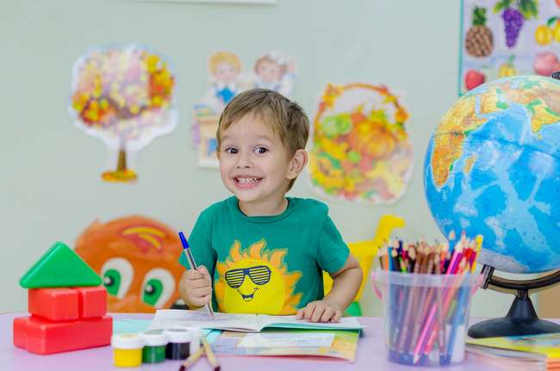
  Check The Imagine Project Spotify playlist for possible songs. Song suggestions: “Imagine” by John Lennon, “Rise Up” by Andra Day
  TASK- start the challenge.

Slide 63
Module 6:
Using The Imagine Project in the classroom

Slide 64

Using The Imagine Project in Groups or Classrooms
World renowned trauma expert Dr. Bruce Perry explains in his book, What Happened to You, that the resilience in this country is diminished because our connectedness is diminished. Social media, the pandemic, and a host of other causes have created a relational poverty with children and adults. We need the emotional support of being connected to others to withstand life’s challenges. When the Imagine Project is used in a group (family is a group) or classroom and kids are given the opportunity to read their stories out loud, a connectedness is created. A sense of understanding ourselves and each other–creating camaraderie and security in knowing that you aren’t alone navigating this sometimes difficult world, and that others also have challenges they face. It’s truly beautiful to watch this process unfold in a group/classroom.

Slide 65
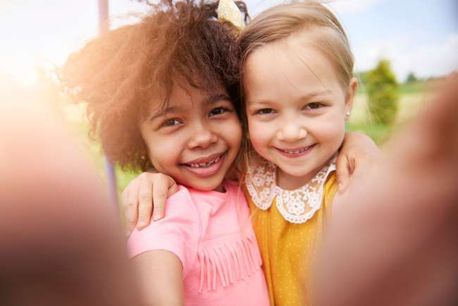
  Equity (Four Agreements): Watch this video explaining using the Four Agreements in a classroom or group setting while using The Imagine Project sets clear norms for the experience.
  How to present brain research on stress and learning to a group of students: Watch this video to learn more about how stress affects the brain and the ability to learn.

Slide 66
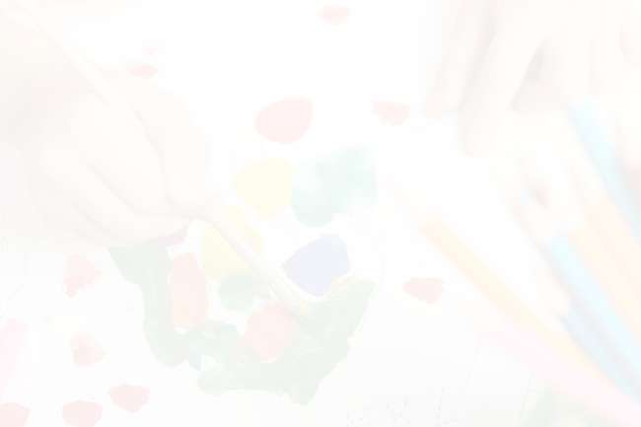
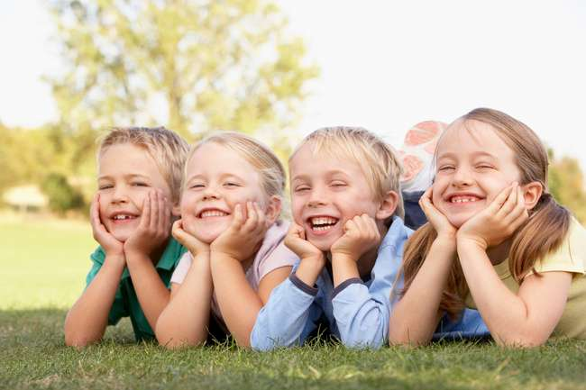
Holding Brave Space
After steps 3 and 4 we encourage participants to share their stories out loud with each other. Some will share, some won’t. It’s okay either way, it’s their decision. When they do share it’s important to know how to hold space for those who are sharing, and teaching others in the group or classroom to hold a brave space. These videos explain more about holding space for sharing.

Slide 67
Holding brave space in a group or classroom.

Slide 68
This is a wonderful children’s book about holding space. “The Rabbit Listened”

Slide 69
Releasing Stress
There are many ways to release stress with kids. Here’s a few ideas:
  Running, jumping, playing, or just being silly.
  Dancing: Gonoodle.com is a great website for younger kids.
  Tapping: also called Emotional Freedom Technique (EFT). Go to this website to learn more about this simple and effective way to release stress. https://theimagineproject.org/etf-tapping/

Slide 70
Dos and Don’ts
  DO:
      Have students read their stories together in a group (this is optional).
      Clap after each student reads their stories.
      Teach compassion, respect, attention, and even have other students visualize wrapping the reader in love (especially with the little ones).
      Have students pick a positive power word that goes along with their story. This is helpful in supporting them believe in themselves.
      See them without their story. They need a positive role model to believe in them. If you aren’t sure you can handle being with their emotions, ask a counselor to be in the room with you. Here is a blog to help you help kids who are feeling emotional.
      Download and us the Feelings Wheel to help focus your emotions on your story and your hopeful turn.
      See their resilience and how amazing they are!!
      Send home the parent letter before you do the project so parents are aware of what the kids are doing.

Slide 71
Dos and Don’ts
  DON”T:
    Read the student’s story if you’ve told them you’re not going to read it (we suggest telling the kids no one needs to read their stories if they don’t want anyone to).
    Send them home on a Friday after reading their story from step 3.
    Try to fix them, it’s okay if they cry, let them feel their emotion, care for them through it. In the words of Brene` Brown, hold the energy of, “I am here with you.” You aren’t doing therapy with them, you are just giving them a place to be heard.

Slide 72
Survey
Now that you have experienced The Imagine Project, we would like to collect some information that will help us continue to improve. Please complete the following anonymous survey.
Here is the Google Forms Link:

Slide 73
Conclusion

